Slide 1
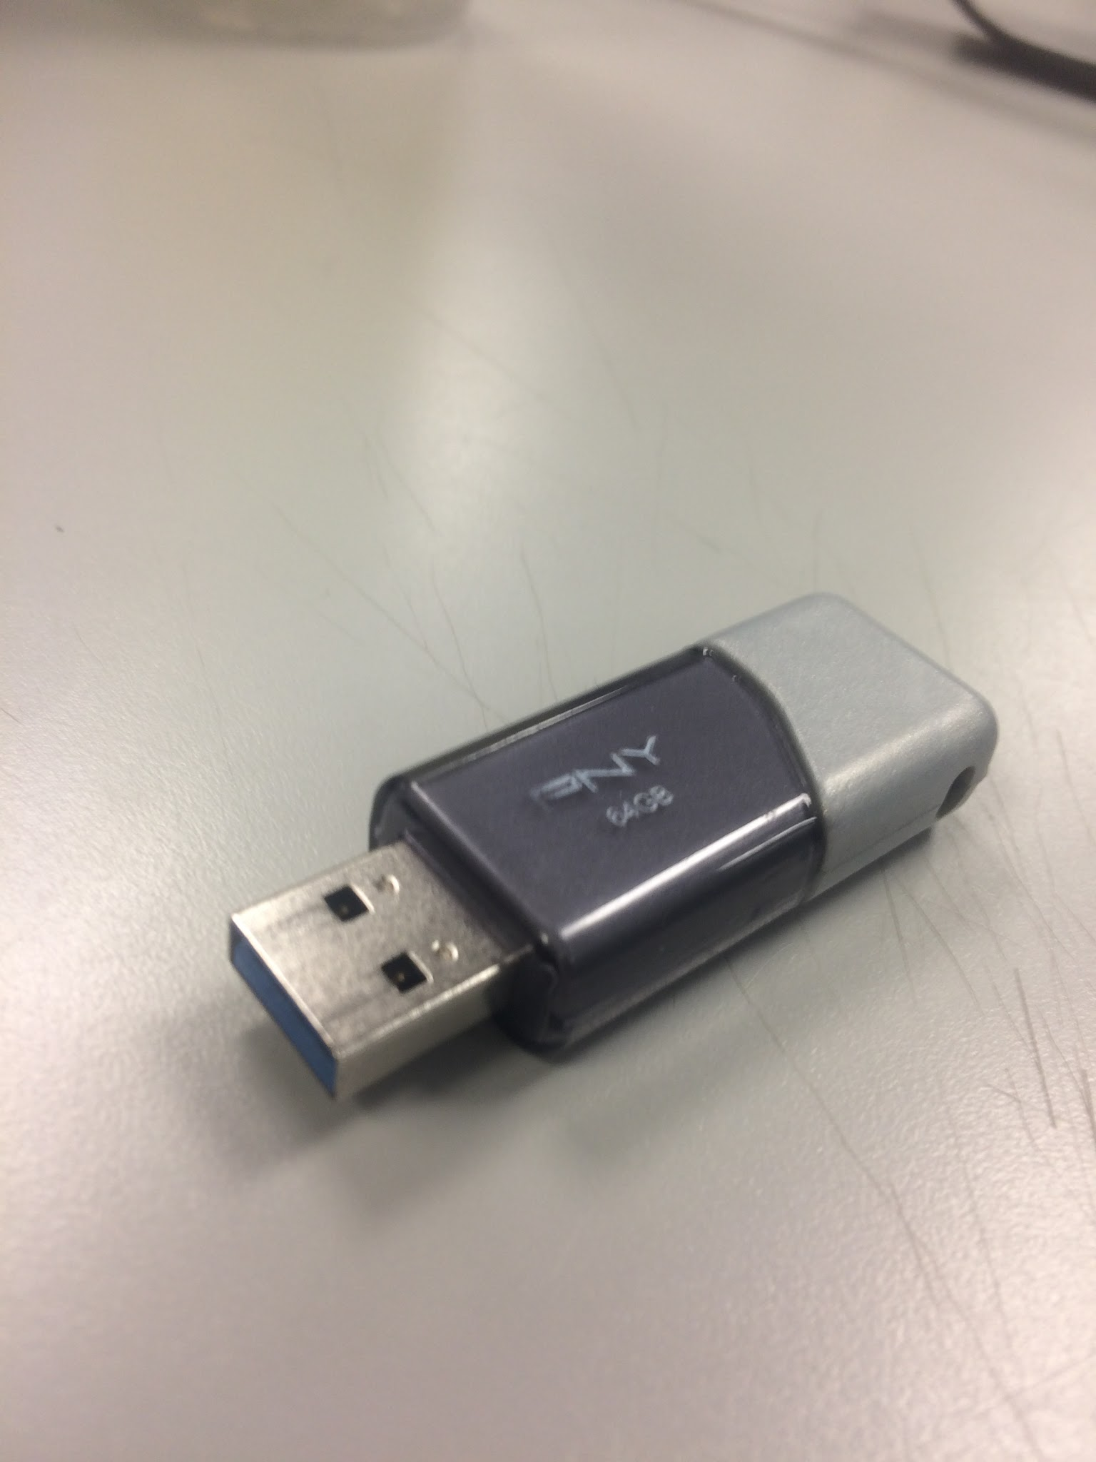
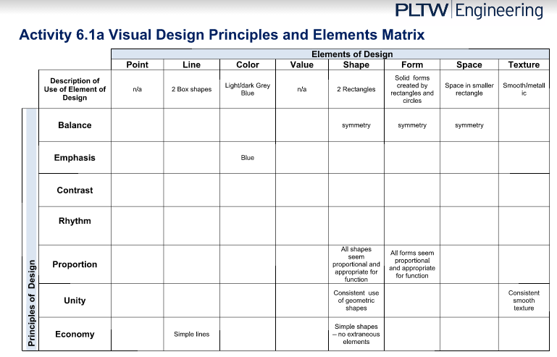

Slide 2
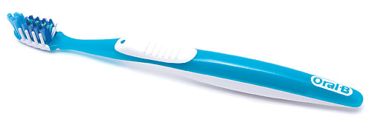
Caleb Cordier
Tooth Brush
Elements: Thin, long, Easy-to-hold
Principles:
Emphasis - Bright colours, plastic
Contrast -Bright colours, the brushes
Formal Balance - symmetrical from some POVs
Regular Rhythm - Created by designs for lines
Proportion - All elements seem proportional
Unity - Smooth, use of geometric shapes, and colour
Economy - Simply lines and shapes

Slide 3
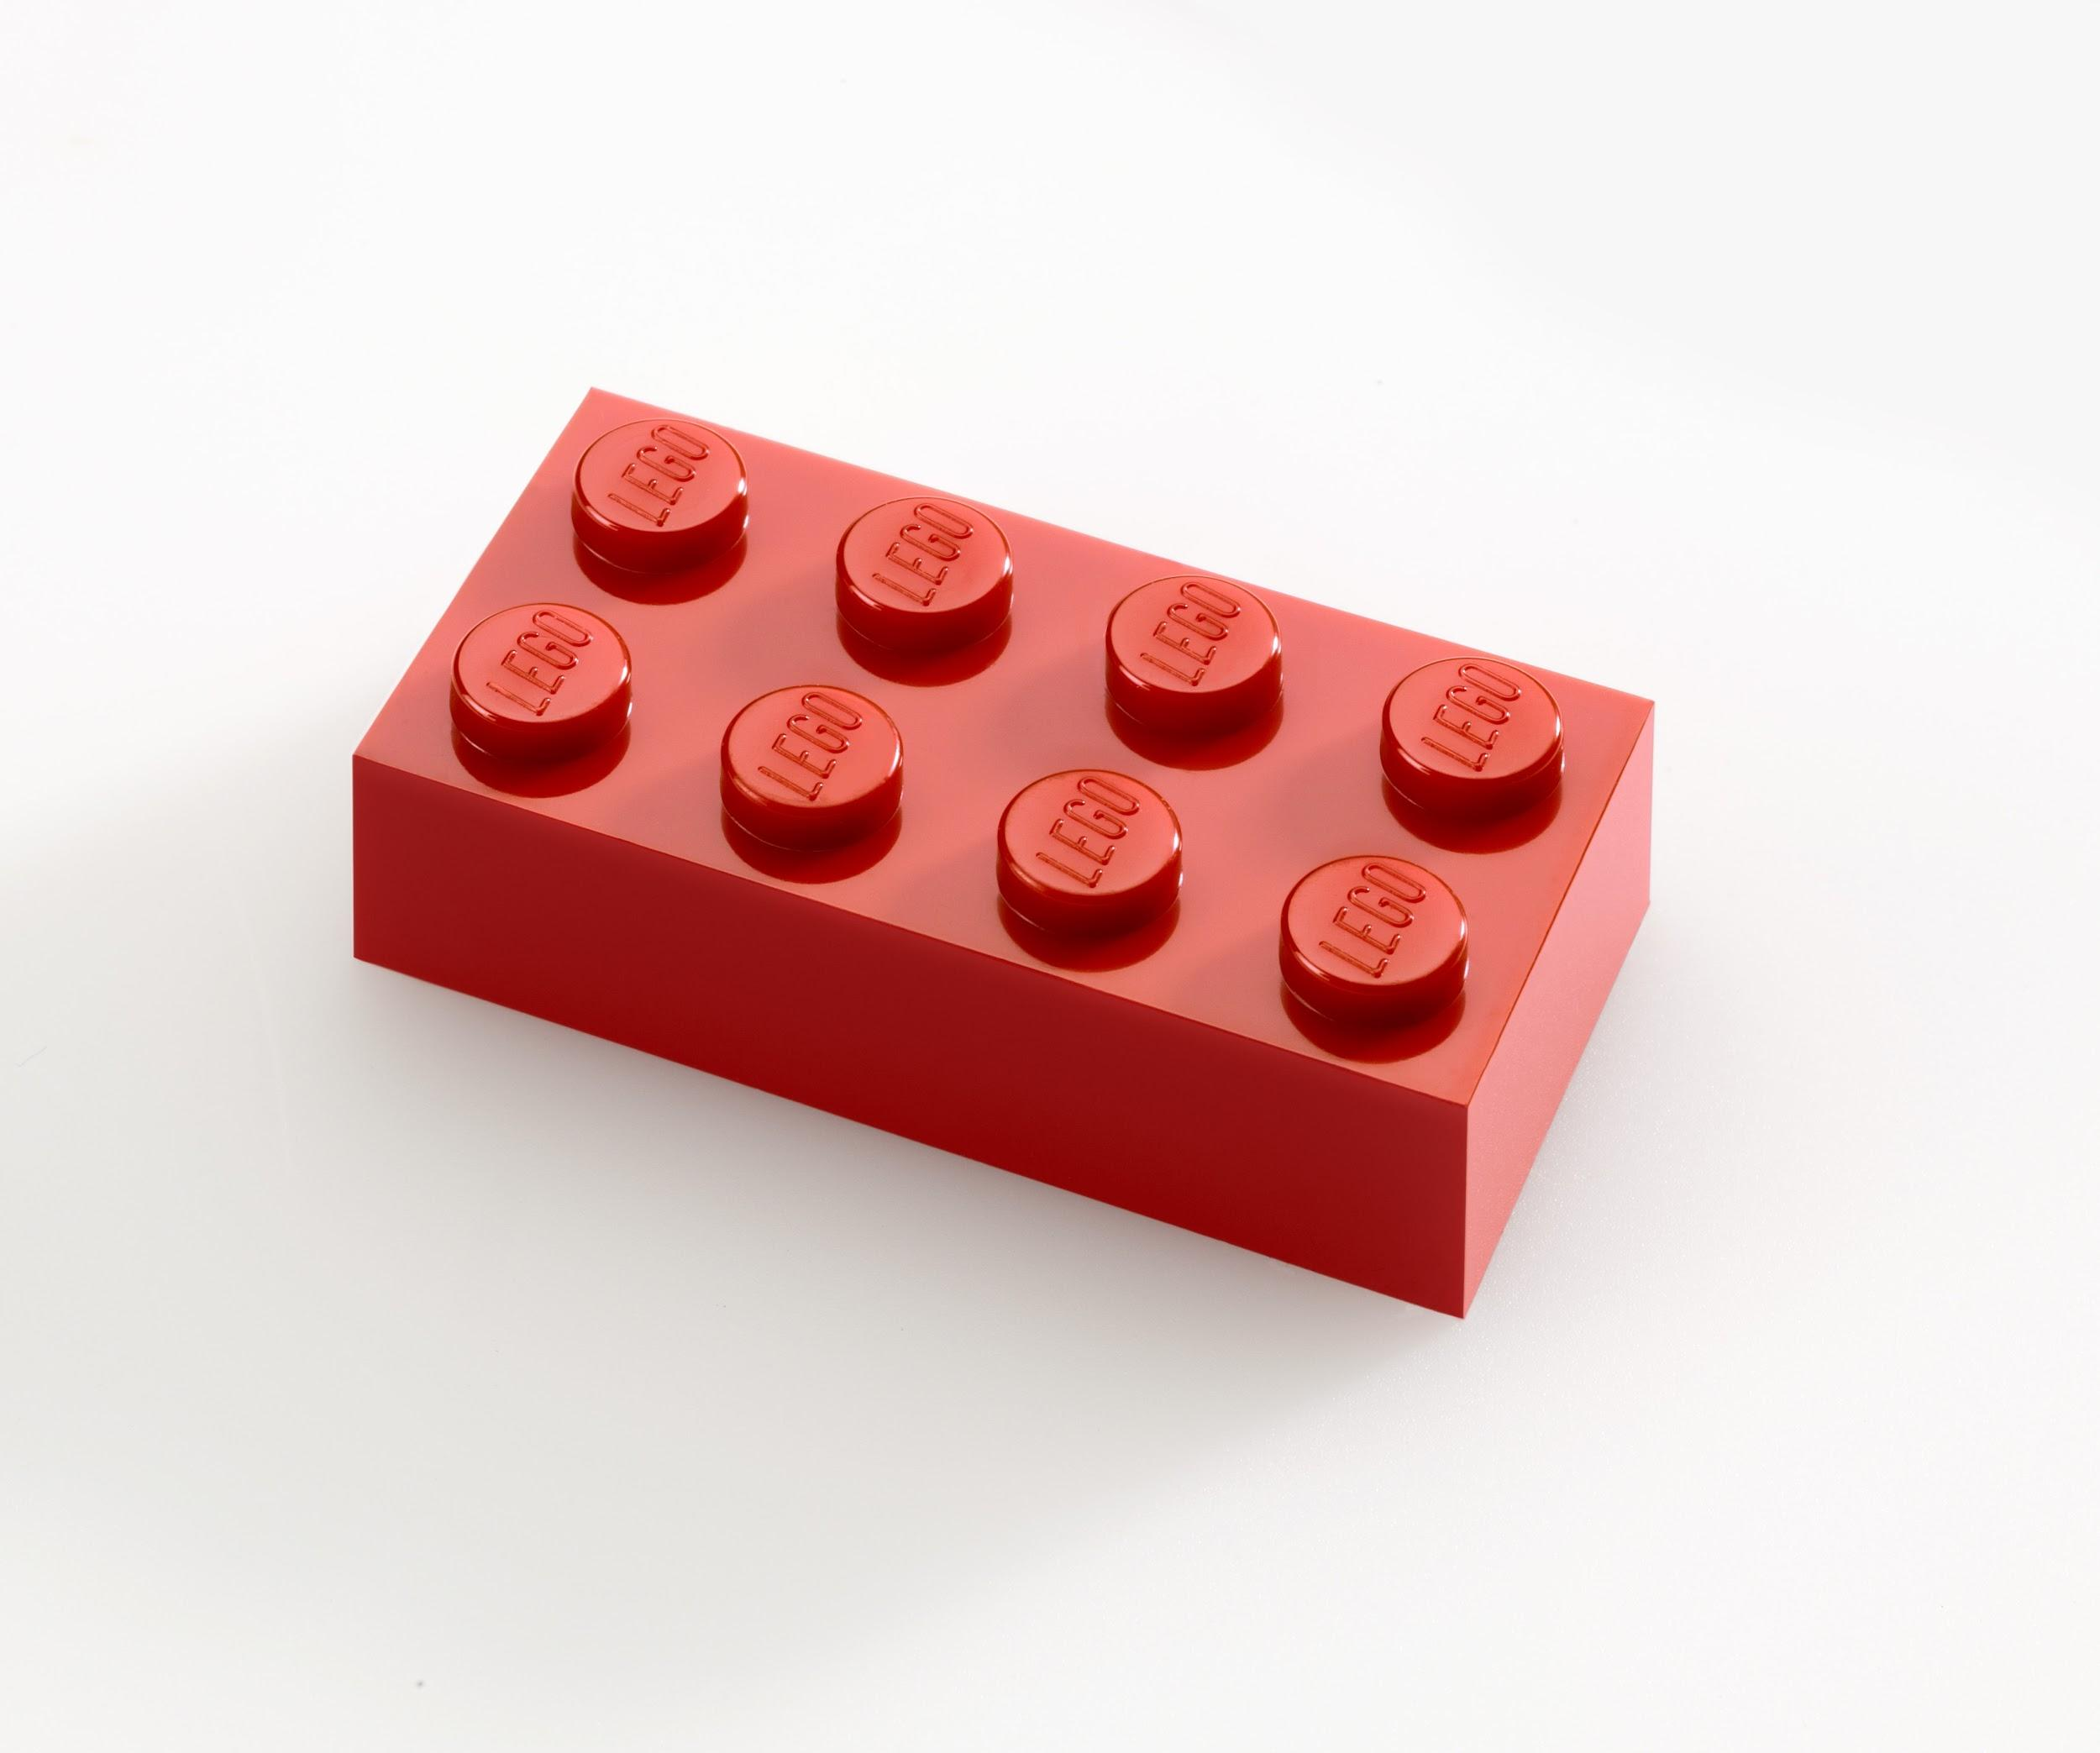
Jordan Davison:
Lego Brick
Elements: Bright red, curved circles on top, overall rectangle shape, smooth-ish texture
Principles: Emphasis - Red Colour.
Contrast - Circles on top of rectangle
Formal Balance - Symmetrical, with organization
Regular Rhythm - created by repeated use of circular parts
Unity - Smooth, use of geometric shapes, and colour
Economy - Simple lines and shapes

Slide 4
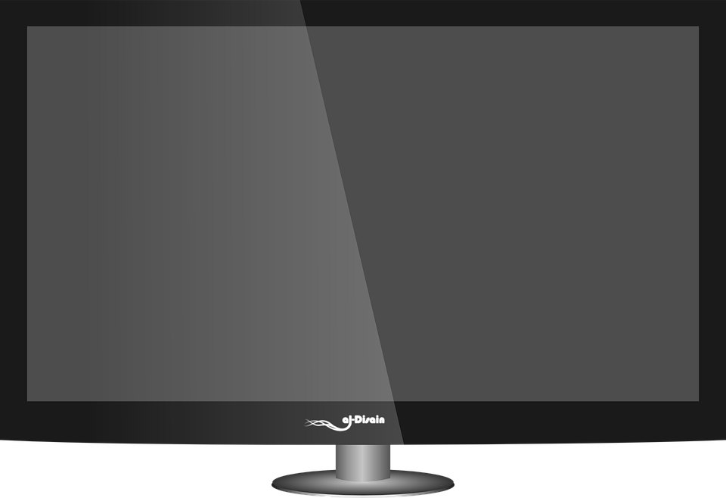
Jaden Allen/Jordan Davison
Television
Elements- rectangle shape, black, screen, tv stand
Principles:
Emphasis- Dark colors, plastic, metals
Contrast- Dark colors, screen
Formal Balance- Symmetrical
Regular Rhythm- Created by lines of metal and plastic
Proportion- All elements seem proportional
Unity- Smooth, use of geometric shapes, and dark color
Economy- Simply lines and shapes

Slide 5
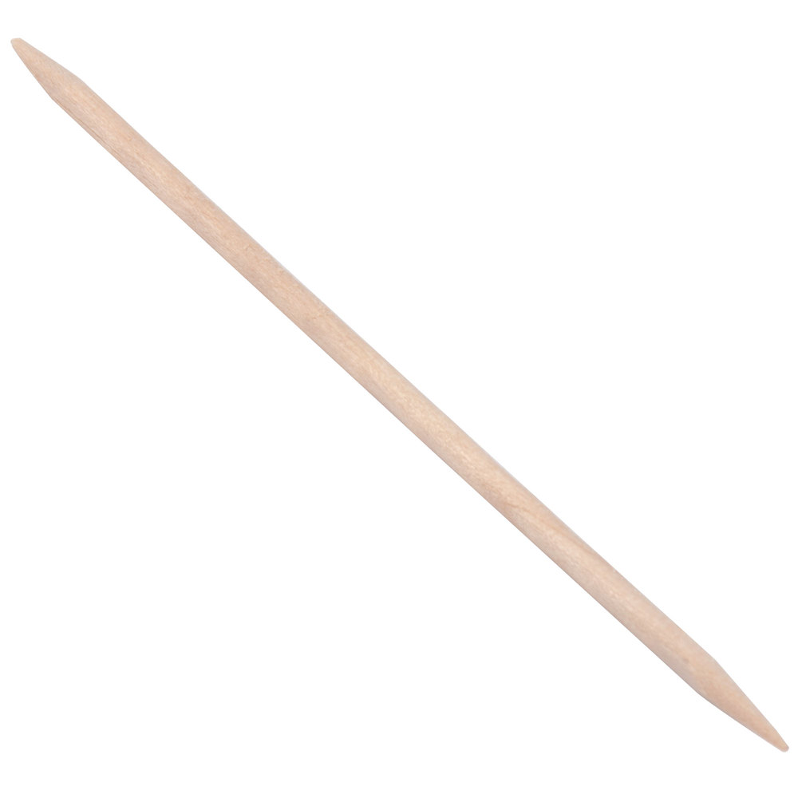

Toothpick
Element - Thin, long, sharp(ish)
Emphasis - Wood-like colour (can vary)
Contrast - Sharp point with smooth body
Formal Balance - Not symmetrical
Regular Rhythm - Created by lines of wood-carving
Proportion - All elements are proportional
Unity - Smooth, use of geometric shapes, and colour
Economy - Simple lines and shapes

